Slide 1


Slide 2
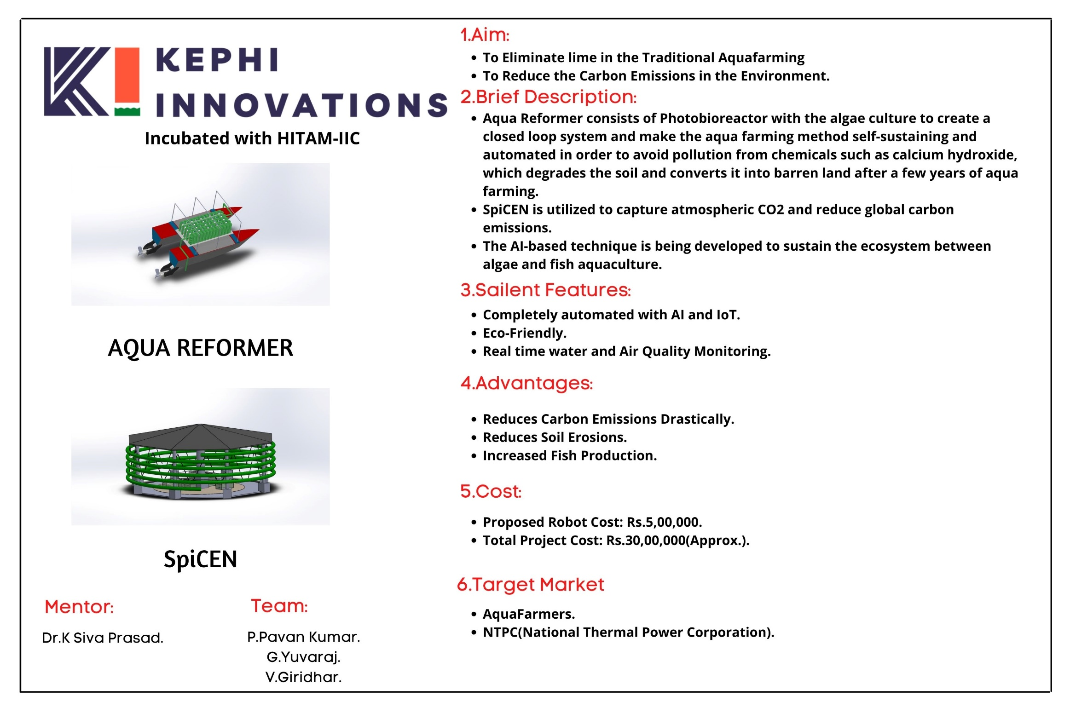

Slide 3
KEPHI INNOVATIONS PRIVATE LIMITED
Date of Incorporation:- 18th February 2022
CIN: U74999TG2022PTC159893.
DPIIT Recognition No: DIPP95484
Directors& Designation:
1.V.Giridhar-(2nd Year MECH)-MD.
2.P.Pavan Kumar-(2nd Year AI&ML)-CEO.
3.G.Yuvaraj-(2nd Year AI&ML)-CTO.
Mentor:
Dr. K Siva Prasad-Assistant Director Doing Engineering.

Slide 4
ACHIEVEMENTS

Slide 5
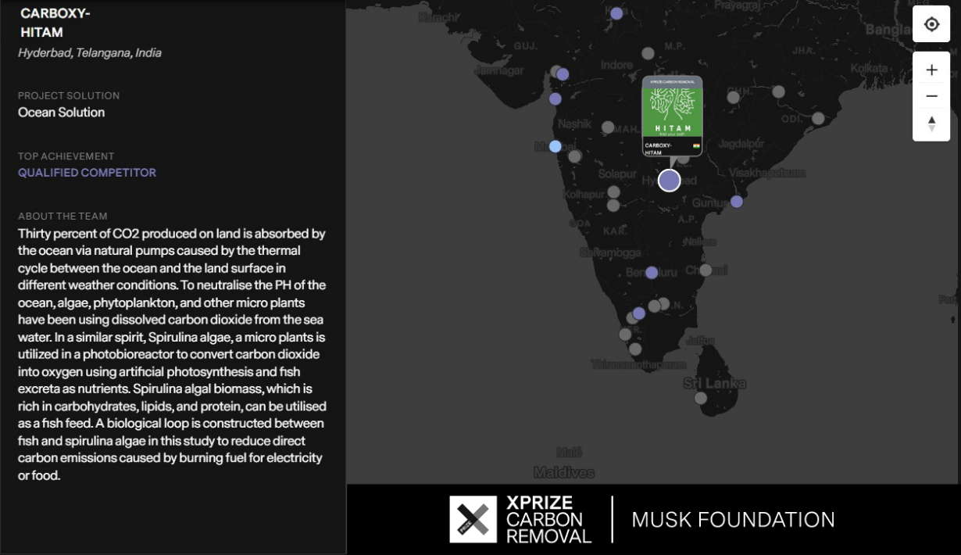
DEVELOPMENT OF CARBON NEUTRAL TECHNOLOGY FOR CLIMATE CHANGE USING EMERGING TECHNOLOGIES.
Qualified Competitor-XPRIZE Carbon Removal, Musk Foundation-2021
We’re proud to be one of 1,133 teams as a qualified competitor signed up for the $100M XPRIZE Carbon Removal-Elon Musk foundation to create real solutions.

Slide 6
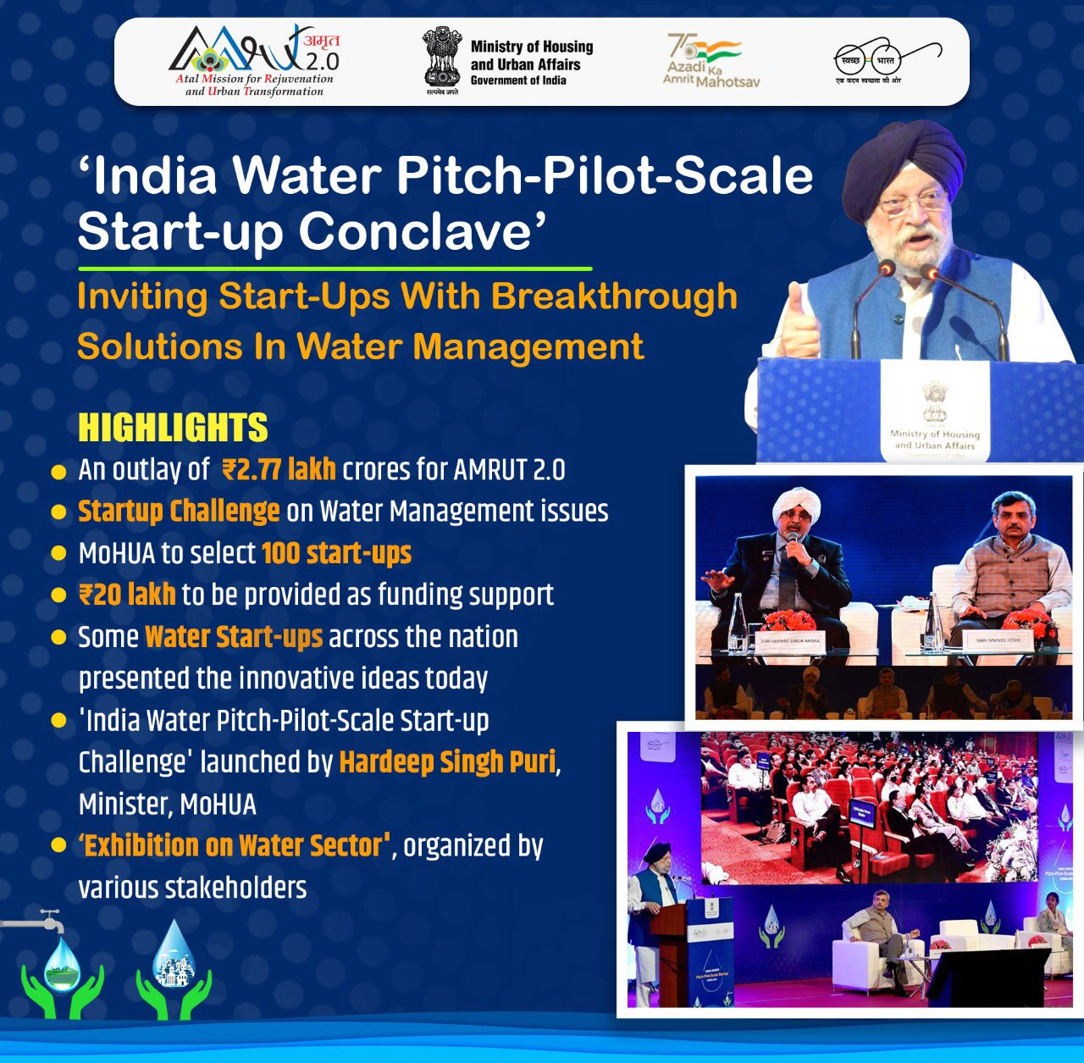
AMRUT 2.0 India Water Pitch-Pilot-Scale Start-up Challenge
KEPHI INNOVATIONS form HITAM Innovation and Incubation Centre(HIIC) was the one of the 100 start-ups across the country to receive a Grant of 20Lakhs to implement and demonstrate our solution AQUA-REFORMER at Warangal

Slide 7
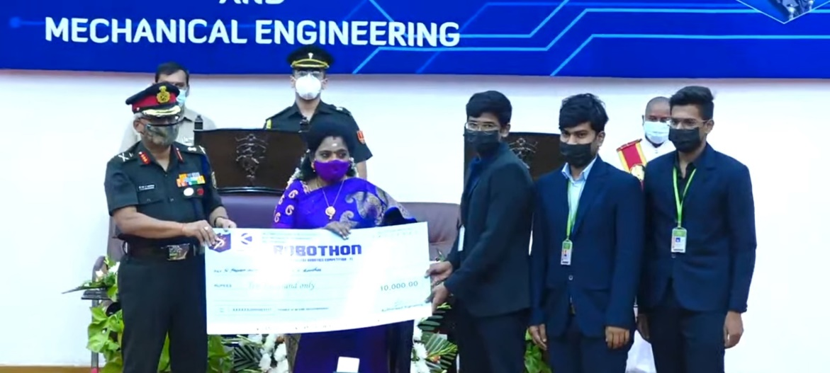
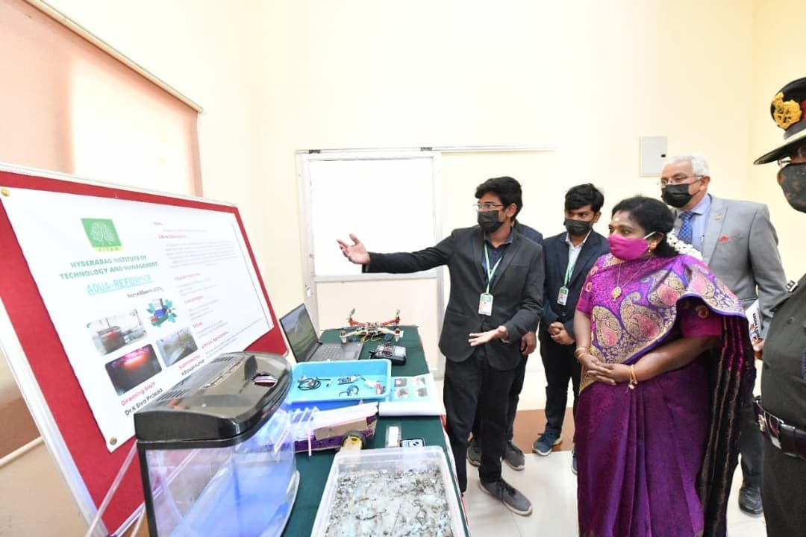
ROBOTHON-2021
Won cash award of Rs.10,000/- and title of Best Expo Project at Military College Of Electronics and Mechanical Engineering (MCEME)'s Robothon Contest 2021, Felicitated by the Governor of Telangana, Dr. Tamilisai Soundararajan.

Slide 8


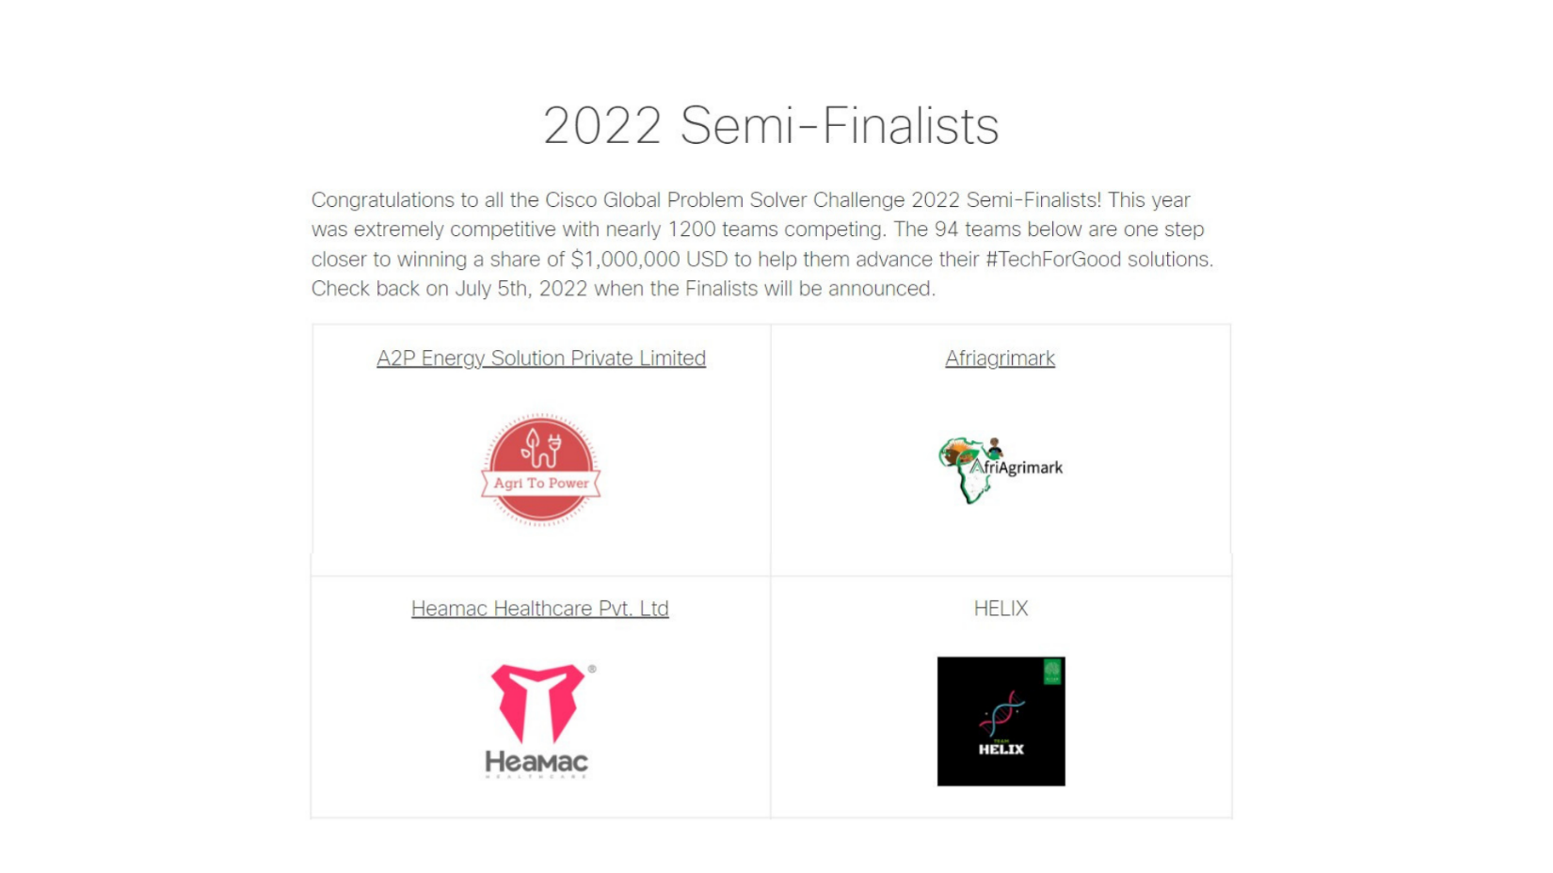
This year was extremely competitive with nearly 1200 teams competing. The 94 teams below are one step closer to winning a share of $1,000,000 USD to help them advance their #TechForGood solutions.

Slide 9

National finalist-Code Titans 2022-Microsoft Startup Hackathon

Slide 10

Semi-Finalist Microsoft Imagine Cup 2022

Slide 11
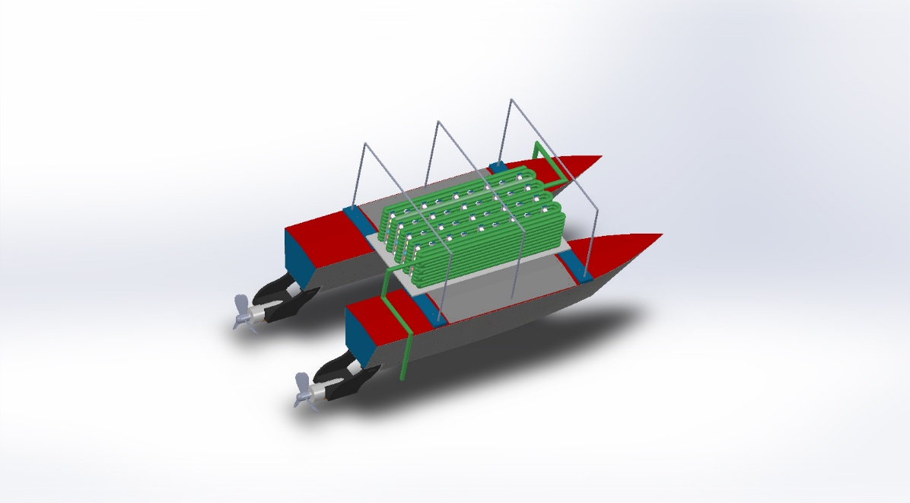
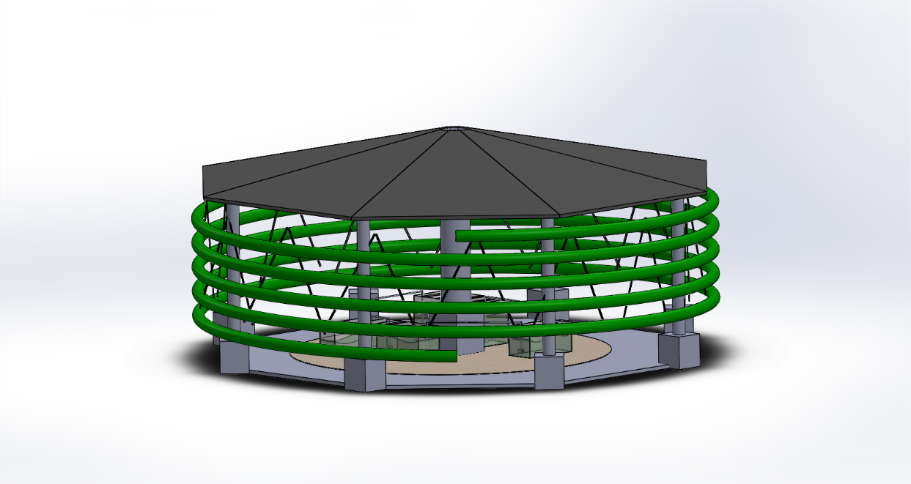
Products:-
AQUA REFORMER
SpiCEN

Slide 12
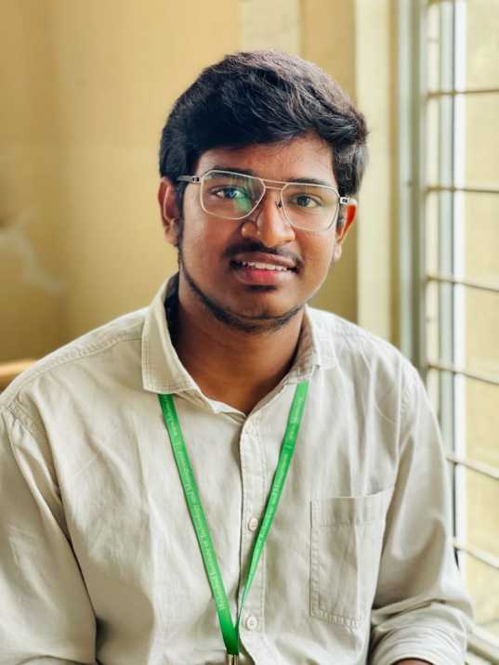
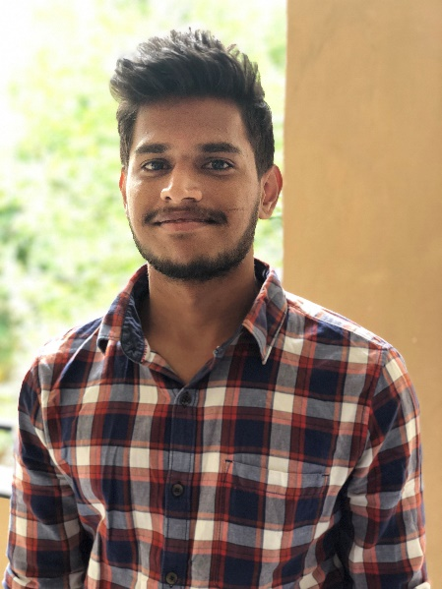
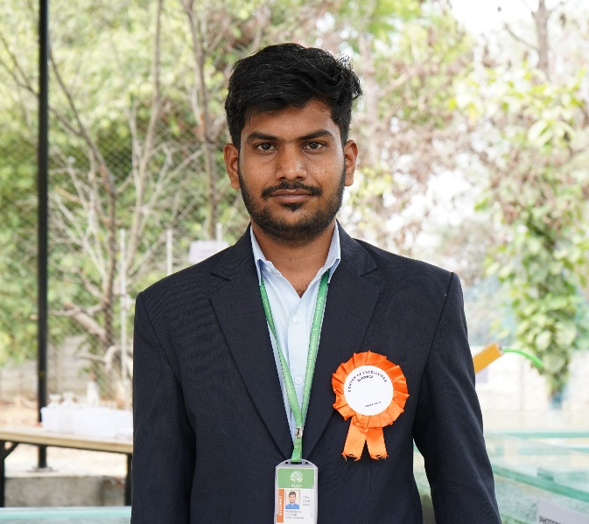
TEAM PHOTOS
P. Pavan Kumar
(2nd Year AI&ML)
G.Yuvaraj
(2nd Year AI&ML)
V.Giridhar
(2nd Year MECH)

Slide 13
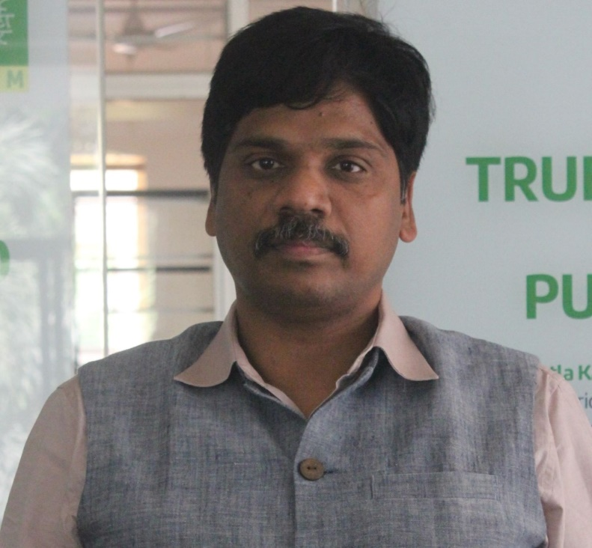
MENTOR
Dr K Siva Prasad-Assistant Director Doing Engineering

